Slide 1
Generative Model Autoencoder (AE) and Generative adversarial network (GAN)
Weijian Deng

Slide 2
Overview
Thanks for giving me the opportunity to talk about the generative model
This talk covers
Supervised learning vs. unsupervised learning
Generative model
Autoencoder (sparse AE); generative adversarial network (GAN)

Slide 3
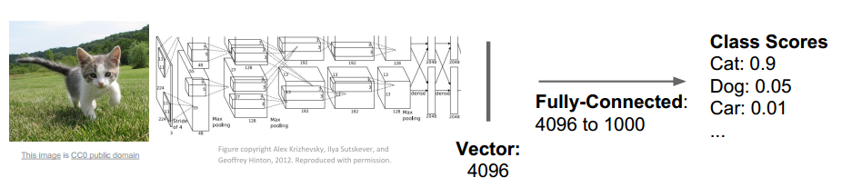
Supervised learning vs. Unsupervised learning
Supervised learning
Data: (x, y)
X is sample, y is label
Goal: learn a function to map x →y
Image classification
cat
A. Krizhevsky, I. Sutskever, and G. Hinton. Imagenet classification with deep convolutional neural networks. In NIPS 2012

Slide 4
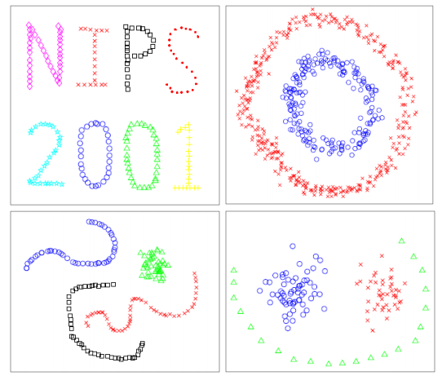
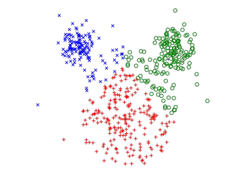
Supervised learning vs. Unsupervised learning
Unsupervised learning
Data: x
X is sample, no label
Goal: learn underlying hidden
structure of data
Clustering
A. Ng, M. Jordan, and Y. Weiss. On spectral clustering: analysis and an algorithm. In NIPS 2002.

Slide 5
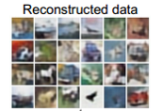
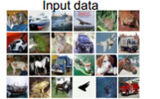
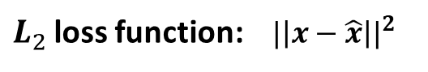

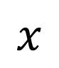

Supervised learning vs. Unsupervised learning
Unsupervised learning
Data: x
X is sample, no label
Goal: learn underlying hidden
structure of data
Autoencoder
$$\hat{x}$$
Reconstructed
Input data
Decoder
$$a$$
$L_{2}$ loss function: ${|\left|x−\hat{x}\right||}^{2}$
Encoder
$$x$$
Input data

Slide 6
Supervised learning vs. Unsupervised learning
Supervised learning
Data: (x, y)
X is sample, y is label
Goal: learn a function to map x →y
Example: image classification
Unsupervised learning
Data: x
X is sample, no label
Goal: learn underlying hidden
structure of data
Example: clustering, Autoencoder

Slide 7
Supervised learning vs. Unsupervised learning
Supervised learning
Data: (x, y)
X is sample, y is label
Goal: learn a function to map x →y
Example: image classification
Unsupervised learning
understand structure of visual world
Data: x
X is sample, no label
Goal: learn underlying hidden
structure of data
Example: clustering, Autoencoder

Slide 8
Generative model
What I cannot create, I do not understand —Richard Feynman

Slide 9
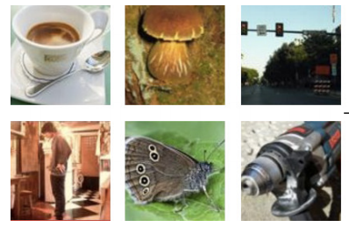
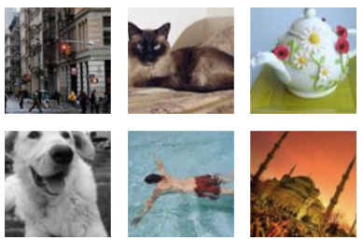
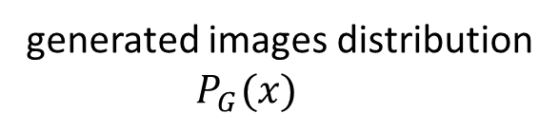
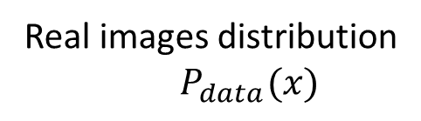
Generative model
Real images distribution
$P_{data}(x)$
generated images distribution
$P_{G}(x)$
We want to learn $P_{G}\left(x\right)$ similar to $P_{data}(x)$

Slide 10
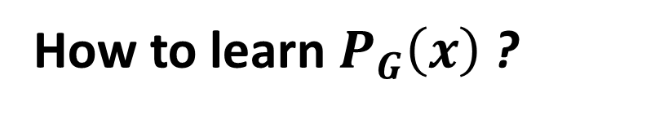
Generative model
Real images distribution
$P_{data}(x)$
generated images distribution
$P_{G}(x)$
How to learn $P_{G}\left(x\right)$ ?

Slide 11

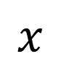

Autoencoder
Autoencoder
Unsupervised approach for learning a lower-dimensional feature representation from unlabeled training data
$$\hat{x}$$
Reconstructed
Input data
Decoder
$$a$$
Encoder
$$x$$
Input data

Slide 12
Autoencoder
Autoencoder
Unsupervised approach for learning a lower-dimensional feature representation from unlabeled training data
$$\hat{x}$$
Reconstructed
Input data
Decoder
$$a$$
Encoder
$$x$$
Input data

Slide 13
Autoencoder
Autoencoder
Unsupervised approach for learning a lower-dimensional feature representation from unlabeled training data
$$\hat{x}$$
Reconstructed
Input data
a usually smaller than x (dimensionality reduction)
Decoder
$$a$$
Encoder
$$x$$
Input data

Slide 14

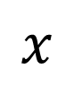

Autoencoder
Autoencoder
Unsupervised approach for learning a lower-dimensional feature representation from unlabeled training data
$$\hat{x}$$
Reconstructed
Input data
Decoder
z usually smaller than x (dimensionality reduction)
$$a$$
Encoder
Features can be used to reconstruct original data
$$x$$
Input data

Slide 15
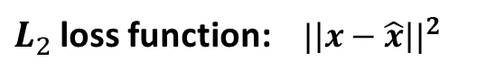
Autoencoder
Autoencoder
Unsupervised approach for learning a lower-dimensional feature representation from unlabeled training data
$L_{2}$ loss function: ${|\left|x−\hat{x}\right||}^{2}$
$$\hat{x}$$
Reconstructed
Input data
z usually smaller than x (dimensionality reduction)
Decoder
$$a$$
Features can be used to reconstruct original data
Encoder
$$x$$
Input data

Slide 16
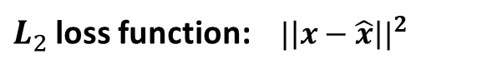
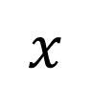


Sparse Autoencoder
$L_{2}$ loss function: ${|\left|x−\hat{x}\right||}^{2}$
$$\hat{x}$$
Reconstructed
Input data
$$a$$
Impose a sparsity constraint
on the hidden layer.
Encoder
$$x$$
Input data

Slide 17
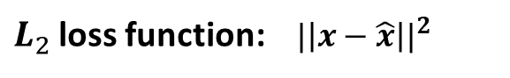
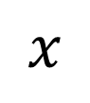


Sparse Autoencoder
$L_{2}$ loss function: ${|\left|x−\hat{x}\right||}^{2}$
$$\hat{x}$$
Reconstructed
Input data
$$a$$
Impose a sparsity constraint
on the hidden layer.
Encoder
$$x$$
Input data
We would like the average activation of each hidden neuron to be a small value (0.05).

Slide 18
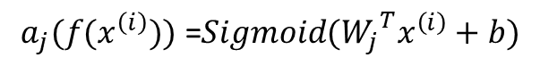

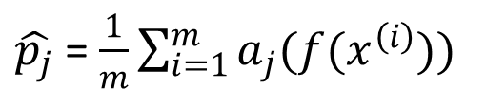
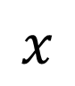

Sparse Autoencoder
$$\hat{x}$$
Reconstructed
Input data
Impose a sparsity constraint
on the hidden layer.
$$a$$
Encoder
$$x$$
Input data
$\hat{p_{j}}$ = $\frac{1}{m}\sum_{i=1}^{m}{a_{j}(f(x^{\left(i\right)})) }$
$a_{j}$denotes the activation of hidden unit j; we have m samples
$$a_{j}(f(x^{\left(i\right)})) \text{=}Sigmoid({W_{j}}^{T}x^{\left(i\right)}+b)$$
Notes:
Want features to capture meaningful factors of variation in data

Slide 19
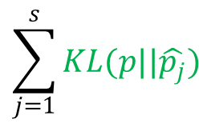

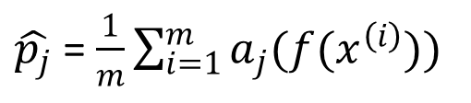
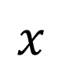
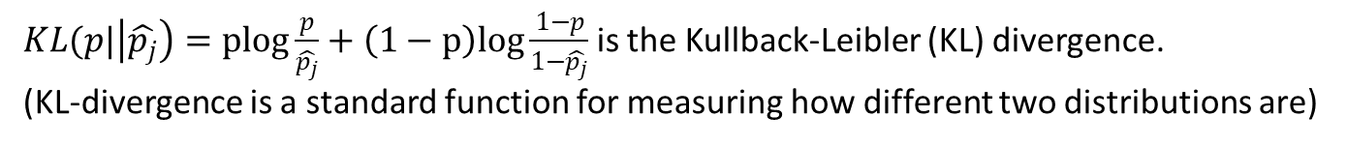

Sparse Autoencoder
$$\hat{x}$$
Reconstructed
Input data
$$a$$
Impose a sparsity constraint
on the hidden layer.
Encoder
$$x$$
Input data
$\hat{p_{j}}$ = $\frac{1}{m}\sum_{i=1}^{m}{a_{j}(f(x^{\left(i\right)})) }$
$a_{j}$denotes the activation of hidden unit j; we have m samples
$$\sum_{j=1}^{s}{KL(p||\hat{p_{j}})}$$
$s$is the number of neurons in the hidden layer; P = 0.05
$KL(p|\left|\hat{p_{j}}\right)=plog\frac{p}{\hat{p_{j}}}+\left(1−p\right)log\frac{1−p}{1−\hat{p_{j}}}$ is the Kullback-Leibler (KL) divergence.
(KL-divergence is a standard function for measuring how different two distributions are)
Notes:
Want features to capture meaningful factors of variation in data

Slide 20
Generative adversarial network (GAN)
GAN is the most important upcoming breakthrough in deep learning. —Yan LeCun

Slide 21
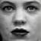
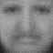
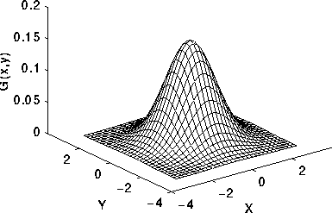
Generative adversarial network (GAN)
Discriminative Model D
1
0
…
…
…
…
…
…
Real image
from real data
Fake image
from G
…
…
Generative Model G
…
p(z)
…
random noise z
…
Ian Goodfellow et al., “Generative Adversarial Nets”, NIPS 2014

Slide 22
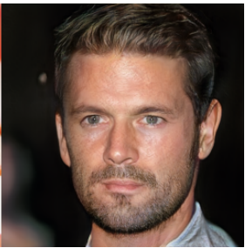
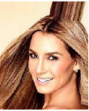
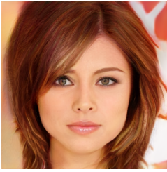
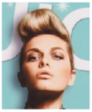
Generative adversarial network (GAN)
Which of the followings are generated/ fake images ?
A
B
C
D
Karras et al, 2017

Slide 23
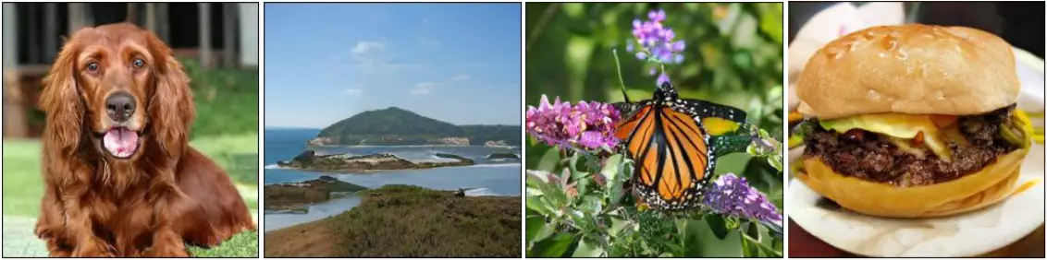
Generative adversarial network (GAN)
Which of the followings are generated/ fake images ?
A
B
C
D
Andrew etal. Large scale gan training for high fidelity natural image synthesis. Arxiv 2018

Slide 24
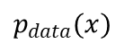
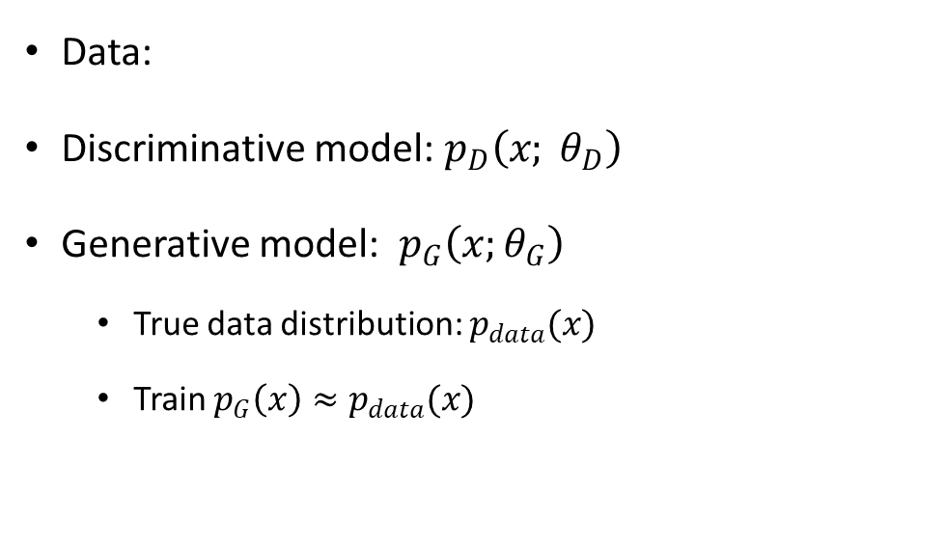
Generative?
…
Data:
Discriminative model: $p_{D}\left(x; θ_{D}\right)$
Generative model: $p_{G}\left(x;θ_{G}\right)$
True data distribution: $p_{data}(x)$
Train $p_{G}\left(x\right)≈p_{data}(x)$
$p_{data}(x)$

Slide 25
Generative adversarial network (GAN)
Discriminative Model D
1
0
…
…
…
…
…
…
Real image
from real data
Fake image
from G
…
…
Generative Model G
…
p(z)
…
random noise z
…
Ian Goodfellow et al., “Generative Adversarial Nets”, NIPS 2014

Slide 26
Generative adversarial network (GAN)
Discriminative Model D
1
0
Try to classify the image x
D(x)=1 when x from real data
D(x)=0 when x from G (generator)
…
…
…
…
…
…
Real image
from real data
Fake image
from G
…
Generative Model G
…
Try to fool the discriminator by
generating real-looking images
…
p(z)
…
random noise z
…

Slide 27
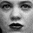
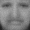
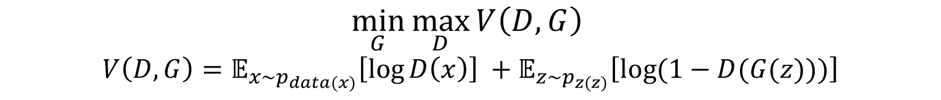
Generative adversarial network (GAN)
$$\min_{G}{\max_{D}{V\left(D,G\right) }}$$
$$V\left(D,G\right)=𝔼_{x\sim p_{data(x)}}\left[\log{D\left(x\right)}\right] +𝔼_{z\sim p_{z(z)}}\left[\log{(1−D(G(z)))}\right]$$
Discriminative Model D
1
0
…
…
Two-player game
…
…
…
…
Alternately optimize G and D
…
Generative Model G
…
…
…
p(z)
random noise z
…

Slide 28
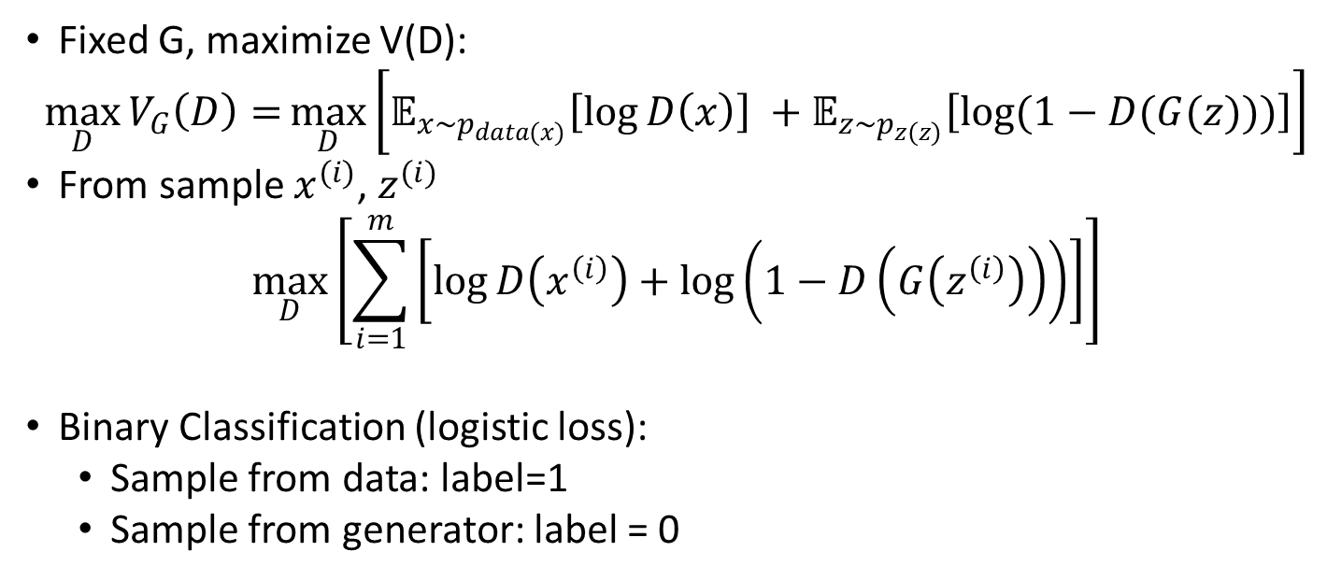
Generative adversarial network (GAN)
$$\min_{G}{\max_{D}{V\left(D,G\right) }}$$
$$V\left(D,G\right)=𝔼_{x\sim p_{data(x)}}\left[\log{D\left(x\right)}\right] +𝔼_{z\sim p_{z(z)}}\left[\log{(1−D(G(z)))}\right]$$
Step 1: Optimize D
Fixed G, maximize V(D):
$$\max_{D}{V_{G}\left(D\right)=}\max_{D}\left[𝔼_{x\sim p_{data(x)}}\left[\log{D\left(x\right)}\right] +𝔼_{z\sim p_{z(z)}}\left[\log{(1−D(G(z)))}\right]\right]$$
From sample $x^{(i)}$, $z^{(i)}$
$$\max_{D}\left[\sum_{i=1}^{m}{\left[\log{D\left(x^{\left(i\right)}\right)+\log\left(1−D\left(G\left(z^{\left(i\right)}\right)\right)\right)}\right]}\right]$$
Binary Classification (logistic loss):
Sample from data: label=1
Sample from generator: label = 0

Slide 29
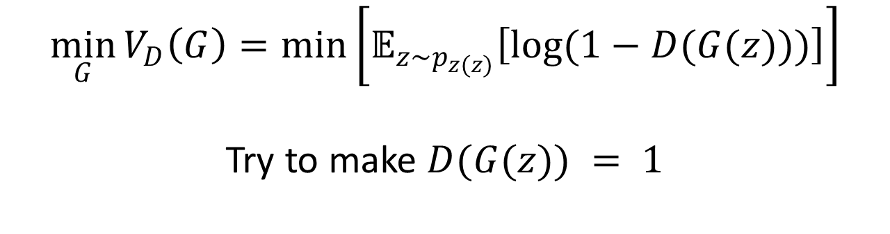
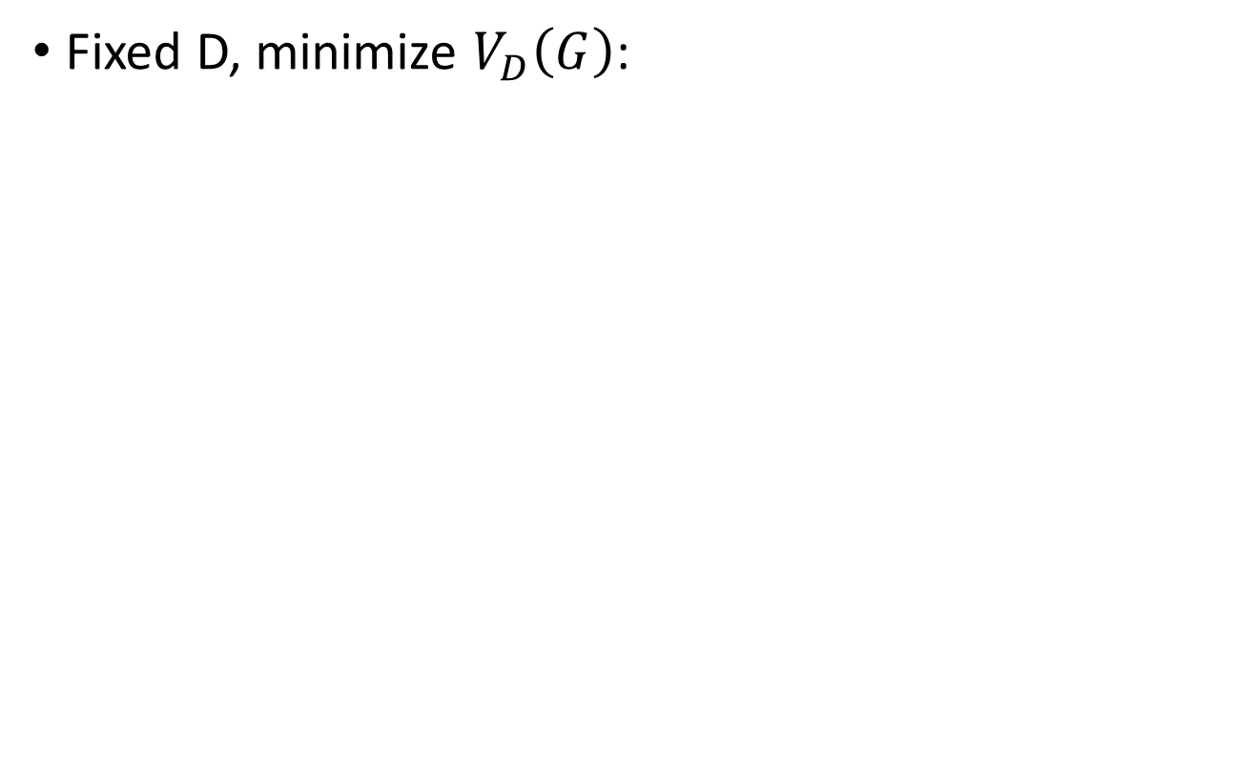
Generative adversarial network (GAN)
$$\min_{G}{\max_{D}{V\left(D,G\right) }}$$
$$V\left(D,G\right)=𝔼_{x\sim p_{data(x)}}\left[\log{D\left(x\right)}\right] +𝔼_{z\sim p_{z(z)}}\left[\log{(1−D(G(z)))}\right]$$
Step 2: Optimize G
Fixed D, minimize $V_{D}\left(G\right)$:
$$\min_{G}{V_{D}\left(G\right)=\min\left[𝔼_{z\sim p_{z(z)}}\left[\log{(1−D(G(z)))}\right]\right]}$$
Try to make $D(G(z)) = 1$

Slide 30
Generative adversarial network (GAN)
$$\min_{G}{\max_{D}{V\left(D,G\right) }}$$
$$V\left(D,G\right)=𝔼_{x\sim p_{data(x)}}\left[\log{D\left(x\right)}\right] +𝔼_{z\sim p_{z(z)}}\left[\log{(1−D(G(z)))}\right]$$
Step 2: Optimize G
Fixed D, minimize $V_{D}\left(G\right)$:
$$\min_{G}{V_{D}\left(G\right)=\min\left[𝔼_{z\sim p_{z(z)}}\left[\log{(1−D(G(z)))}\right]\right]}$$
Try to make $D(G(z)) = 1$
D(G(z) =0, D wins, G fails
D(G(z) =1, D fails, G wins

Slide 31
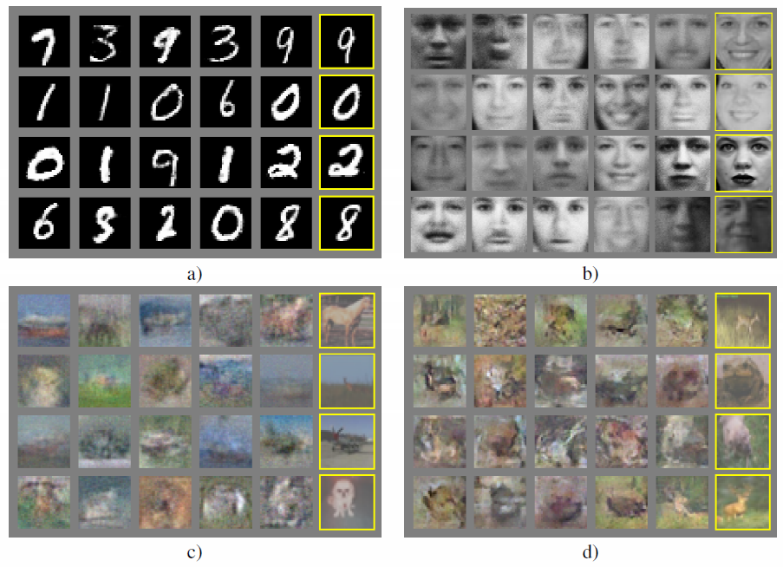
Generative adversarial network (GAN)
Nearest training example
Generated Samples

Slide 32
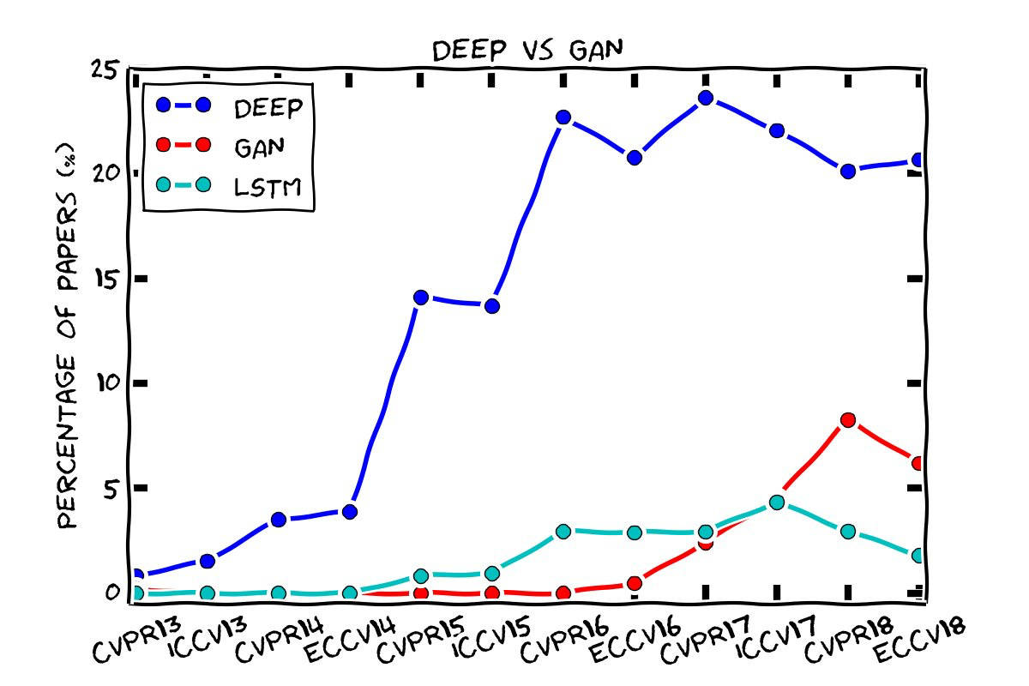
Generative adversarial network (GAN)

Slide 33
Recap
Supervised learning vs. unsupervised learning
Generative model
Autoencoder (sparse AE); generative adversarial network (GAN)

Slide 34
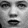
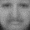
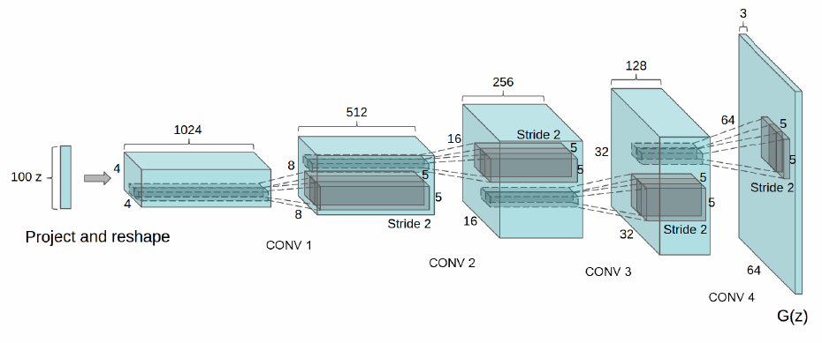
Discriminative Model D
DCGAN (Deep convolutional GAN)
1
0
…
…
…
…
…
…
Replace model’s network to CNN
Example of generator G
(same as D)
…
Generative Model G
…
…
…
p(z)
random noise z
…
z: uniform dist.
Radford A, etal. Unsupervised representation learning with deep convolutional generative adversarial networks. In ICLR 2016

Slide 35
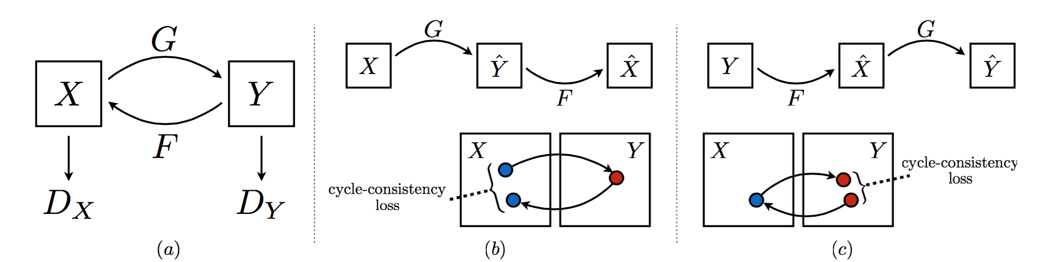
CycleGAN
Zhu, etal. Unpaired Image-to-Image Translation using Cycle-Consistent Adversarial Networks In ICCV 2017

Slide 36
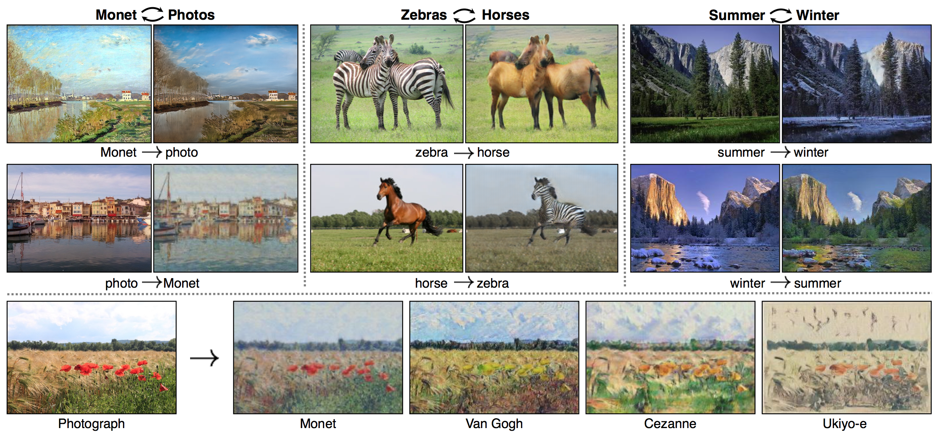
CycleGAN
Zhu, etal. Unpaired Image-to-Image Translation using Cycle-Consistent Adversarial Networks In ICCV 2017

Slide 37
Thank you

